Slide 1
Lease Finder
Groovy Ruby

Slide 2
What is Lease Finder
An easy-to-use web app that bridges the gap between students who are trying to sublease and students looking for a temporary place to stay
Allows landlords to promote their properties and keep their property information up to date
Students able to filter/sort through available listings and see reviews for properties they are interested in

Slide 3
Models

Slide 4
Models: ER Diagram
Landlord
1
Sublet Post
N
N
N
Property
1
1
Student
1
1
Review
N
N

Slide 5
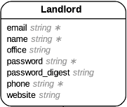
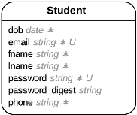
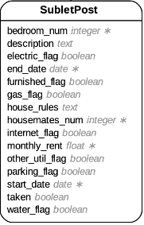
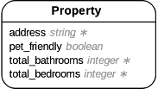
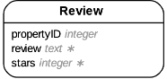
Models: Attributes

Slide 6
Lease Finder Demo!
Notes:
Landing page -> Filtering -> Show a sublet post -> Log in as Student -> Edit sublet post -> Sign up as new Landlord -> Create new property

Slide 7
Rails

Slide 8
Rails Scaffold
rails g scaffold was used to automatically generate files for all the tables in the model
Eg: Generating files for Landlord
rails g scaffold Landlord name:string email:string password:string phone:string website:string Office:string password_digest:string
Notes:
Other data types include integer, boolean, datetime

Slide 9
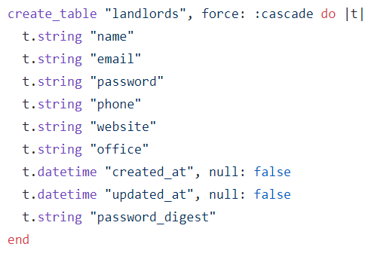
After running the command, run rake db:migrate to update the database schema

Slide 10
Adding Foreign Keys
Certain tables contain references to other tables , add foreign keys
Eg: Create a foreign key that references the landlord for each property
rails g migration AddLandlordEmailToProperty landlord:references

Slide 11
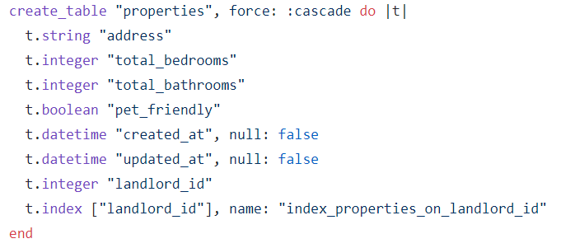
Result after running rake db:migrate

Slide 12
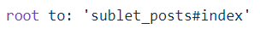
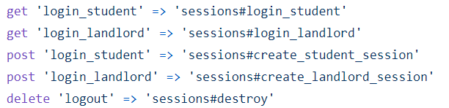
Routes
Root was redirected to the landing page
Additional routes were created to handle user login

Slide 13
Sign Up

Slide 14
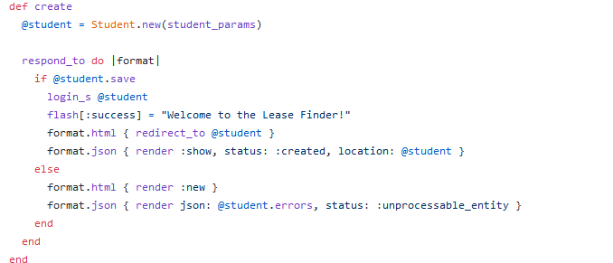
Controller for Signing up
Create new student using params submitted by the form
Auto log in student if signed up successfully, more details later
Friendly notice
Redirect to student account page
Re-render the sign-up page and pass in student errors params if unsuccessful sign ups

Slide 15
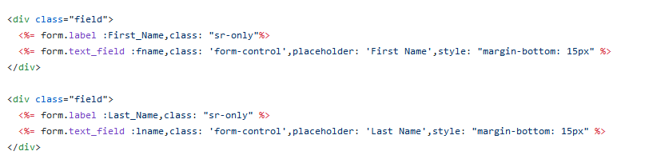
View for Sign Up
Used form_with to generate form using parameterized code
Example of generated fields in the sign-up form

Slide 16
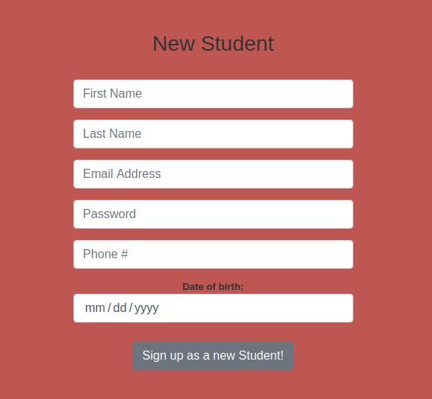
Result

Slide 17
Login And Logout

Slide 18
Adding a secure password
The method is to require each user to have a password, and then store a hashed version of the password in the database.
We also added a way to authenticate a user based on a given password, a method we’ll use to allow users to log in to the site.

Slide 19
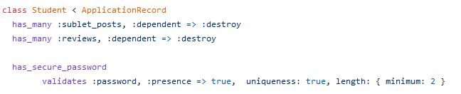
has_secure_password
The ability to save a securely hashed password_digest attribute to the database
An authenticate method that returns the user when the password is correct (and false otherwise)
Gem Bcrypt: state-of-the-art hash function

Slide 20
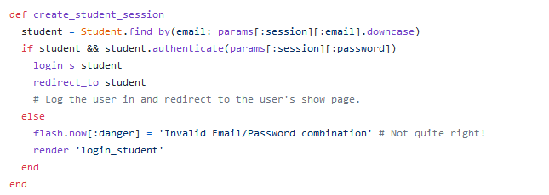
Session controller
Logging in is handled by sending a POST request to the create action
Authenticate method provided by has_secure_password to authenticate user with the database

Slide 21
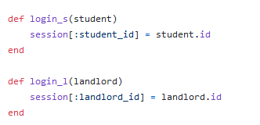
Session Helpers
This places a temporary cookie on the user’s browser containing an encrypted version of the user’s id, which allows us to retrieve the id on subsequent pages.

Slide 22
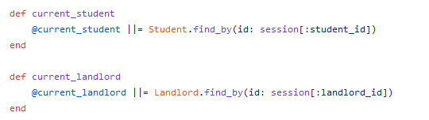
Current User
Defining a current_student and current_landlord method to find the account in the database corresponding to the session id.

Slide 23
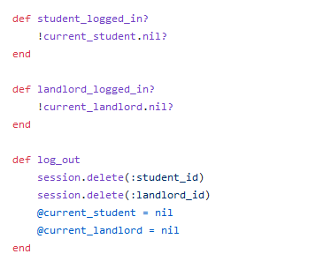
Logged in? & Log out
A user is logged in if there is a current user in the session
Methods to tell whether a student or a landlord is logged in
Critical in changing appearance of the nav_bar
Method to dispose current session and log out the current user

Slide 24
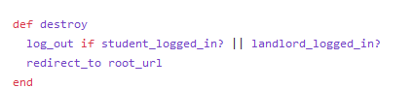
Log out Action
Uses the log_out helper methods within destroy
Redirect user to the root url

Slide 25
Sorting and Filtering

Slide 26
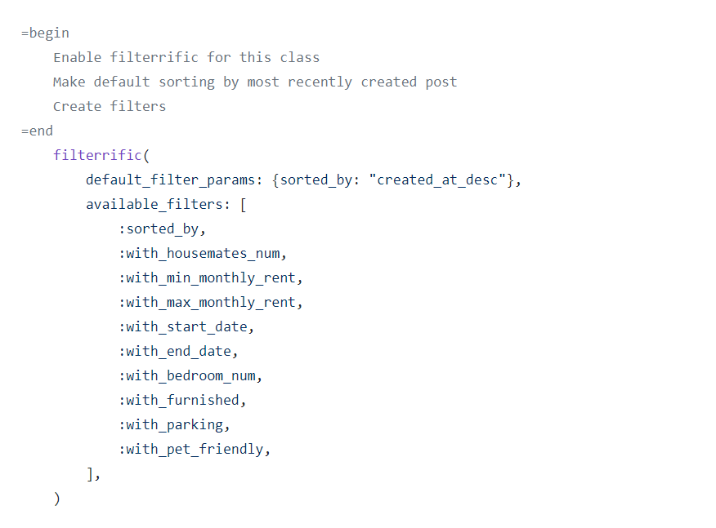
Gem Filterrific
Enable Filterrific in SubletPost model
Define names of the desired filters
Notes:
We enable filterrific by adding this directive to the model, whose objects we are looking to filter and sort. In our case, it’s the SubletPost class.

Slide 27
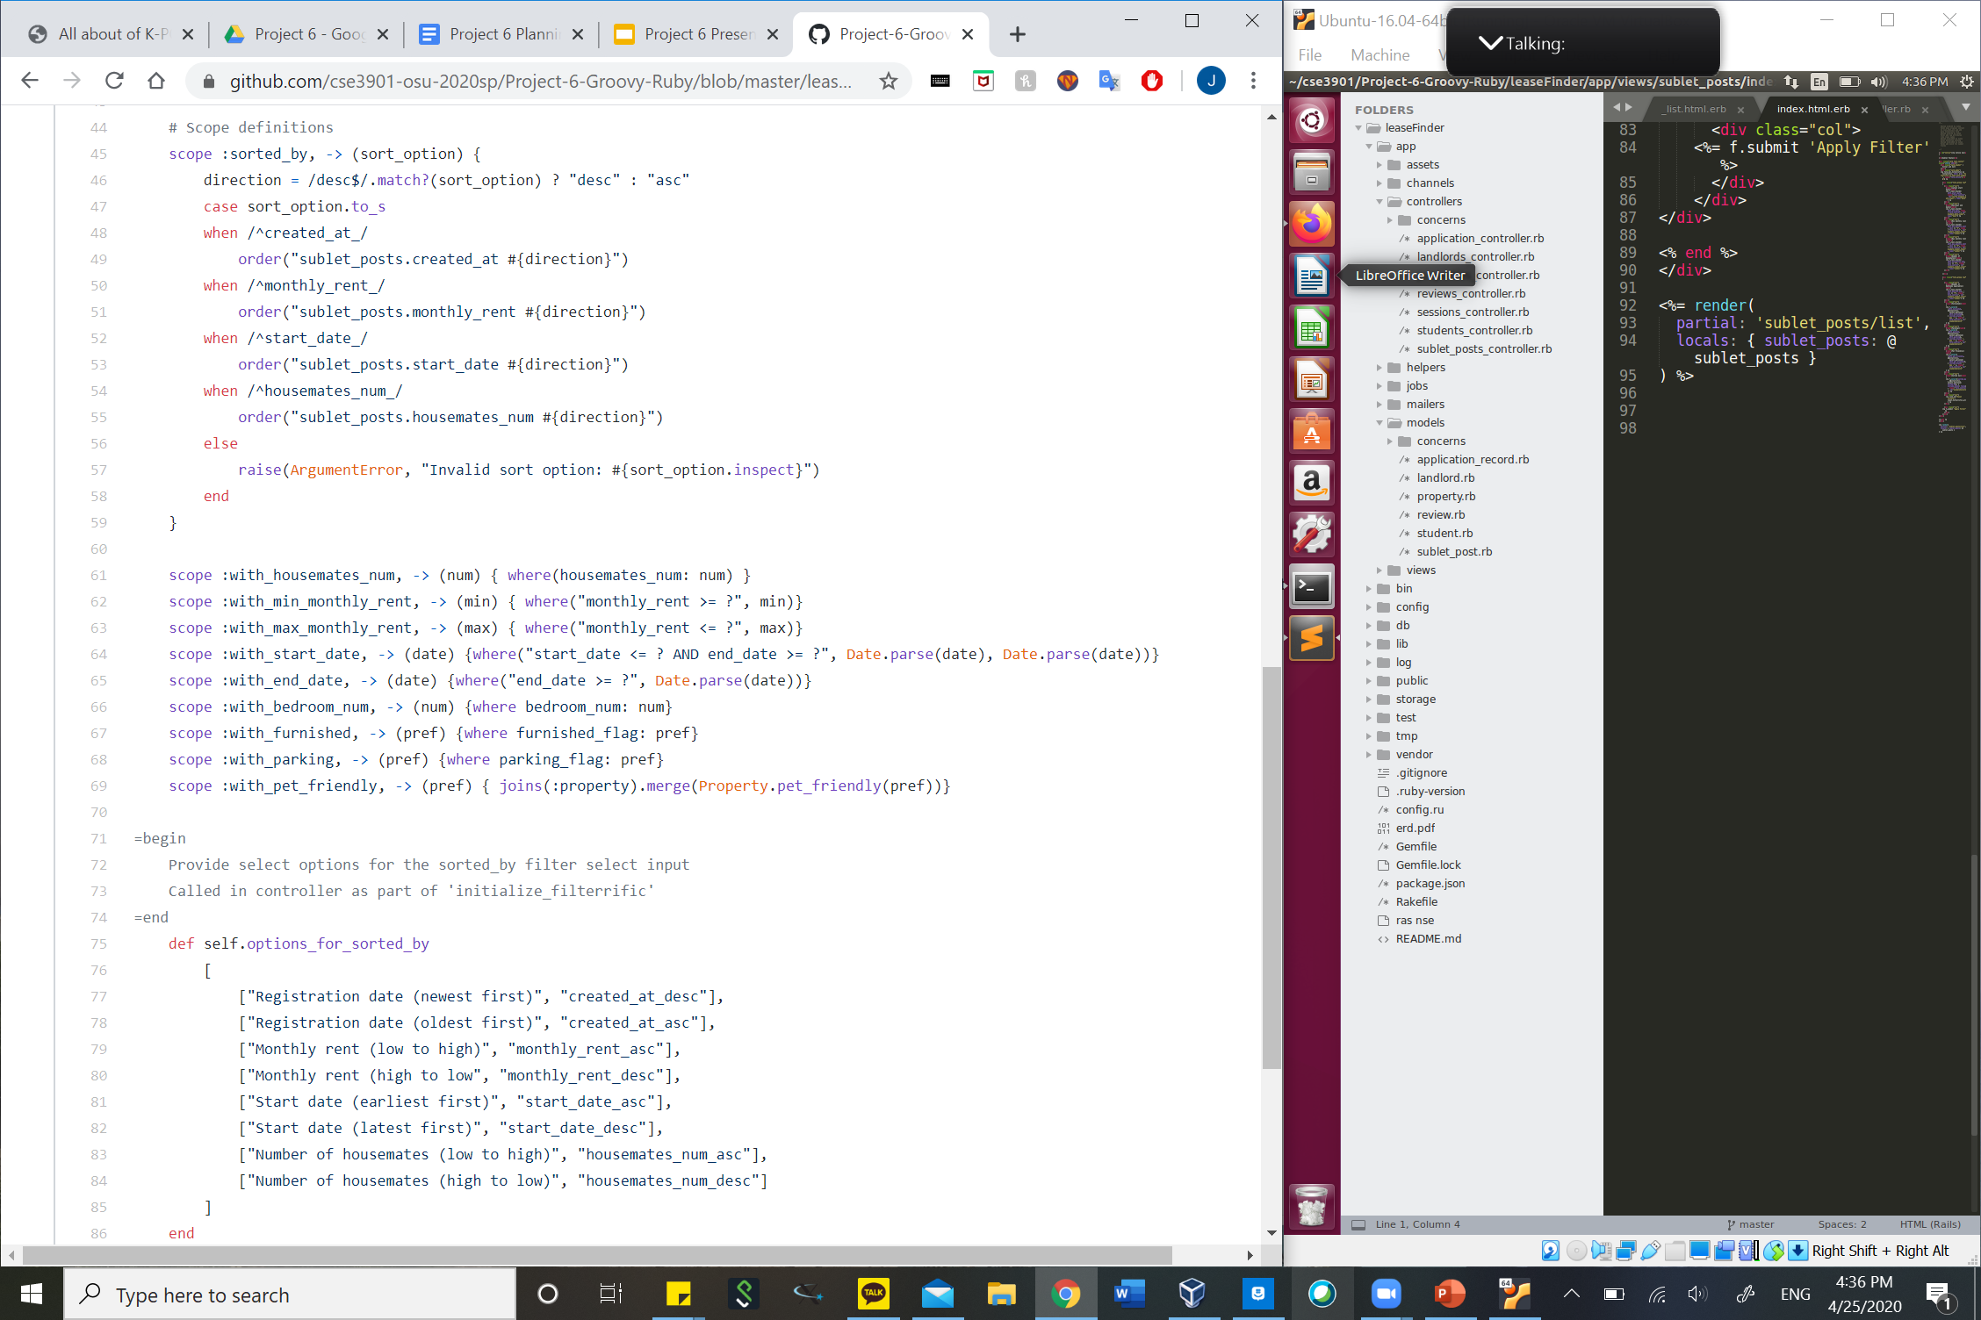
Model: Scope
Scoping = defining custom queries in model code
Implement filters using scope definitions

Slide 28
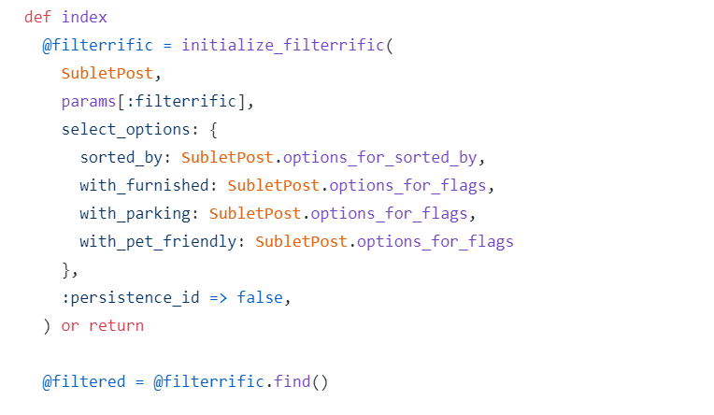
Controller: Initialize
Initialize filterrific in SubletPosts controller
Define parameters from the model code
Define options for select inputs
Find all sublet posts that match the filter parameters

Slide 29
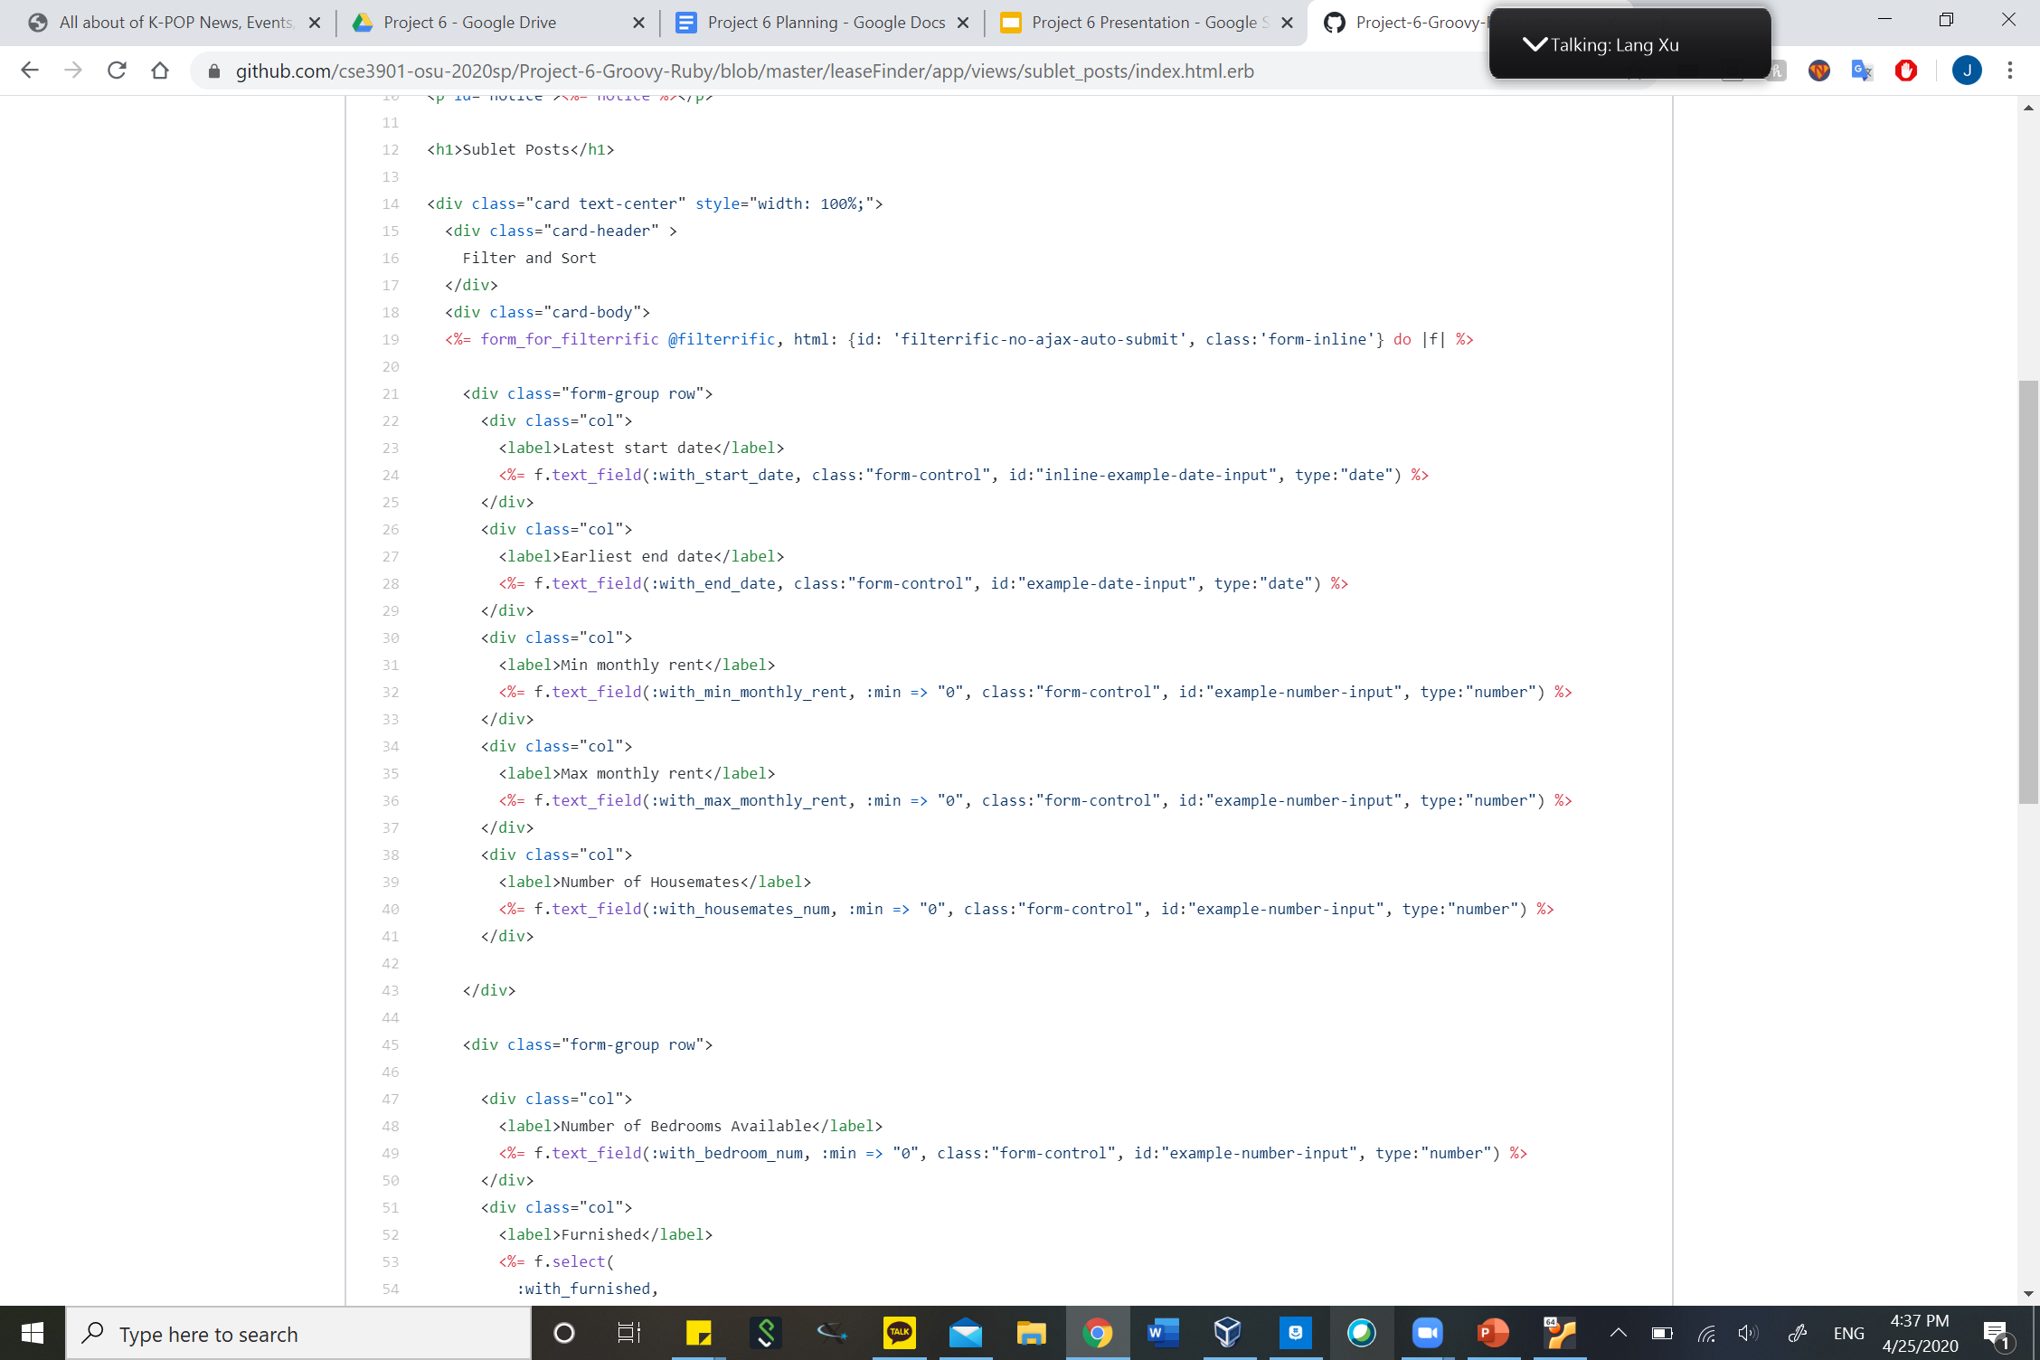
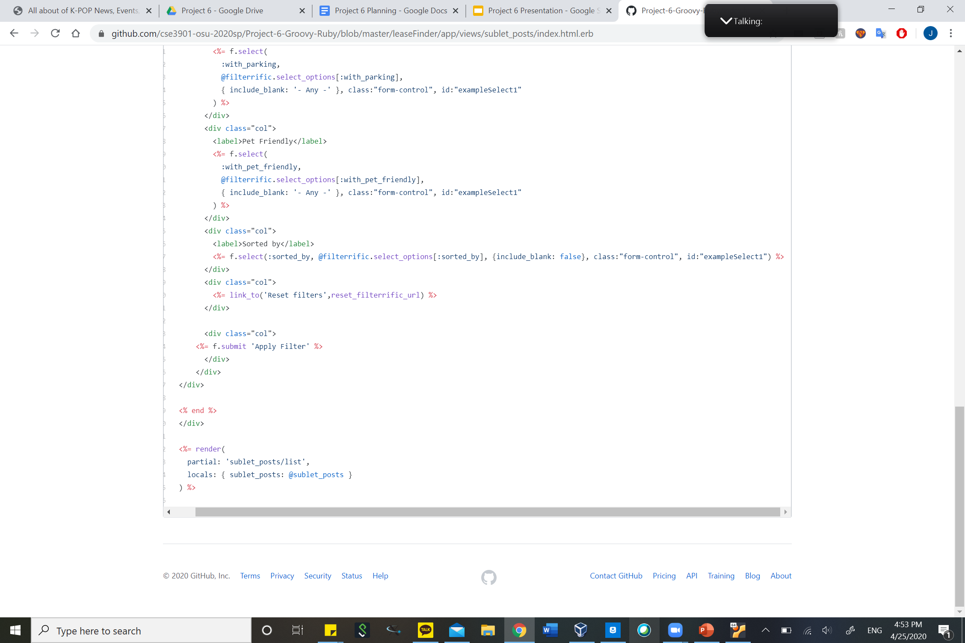
View: Filter Form
Use form_for_filterrific helper method
Set options for select input-type
Add link to reset filters to default input
Render html that displays the results

Slide 30
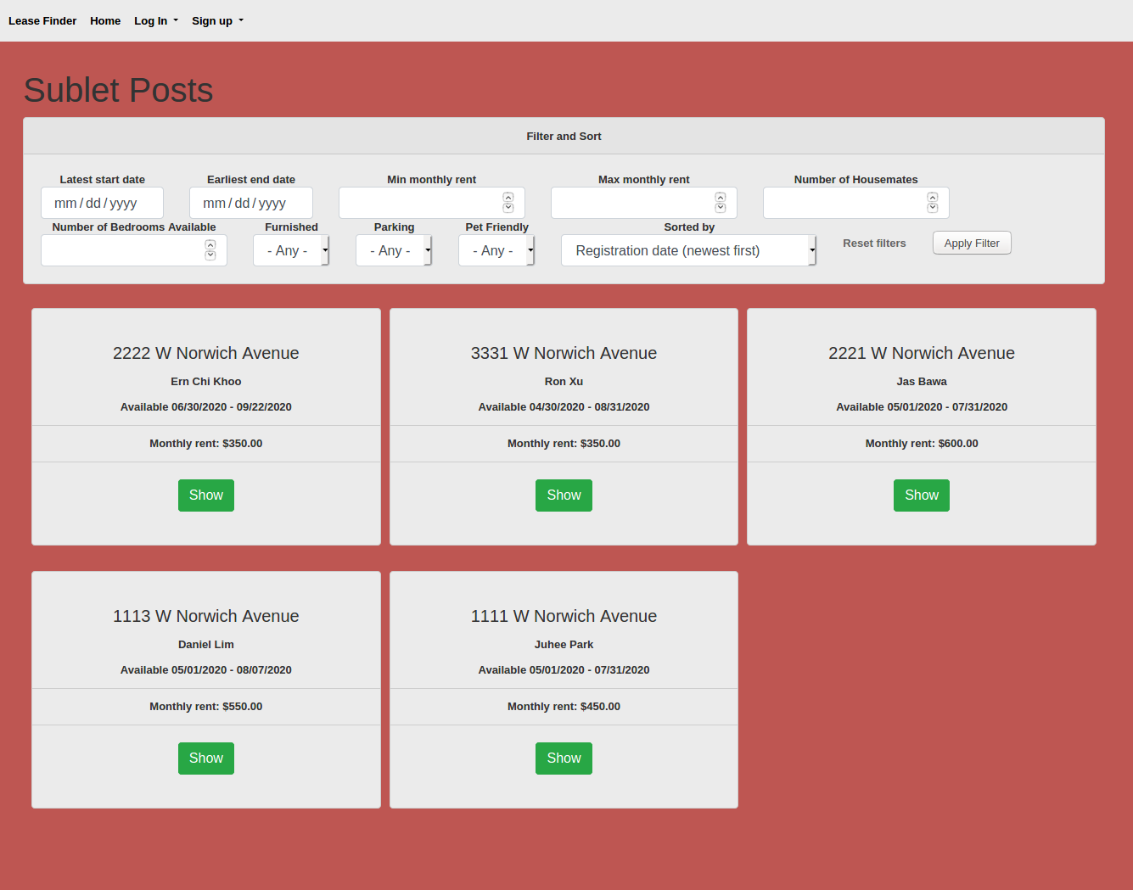
Result

Slide 31
Design of Web App

Slide 32
Design Goals
Give users an interface that is organized
Provide easy action navigation using icons

Slide 33
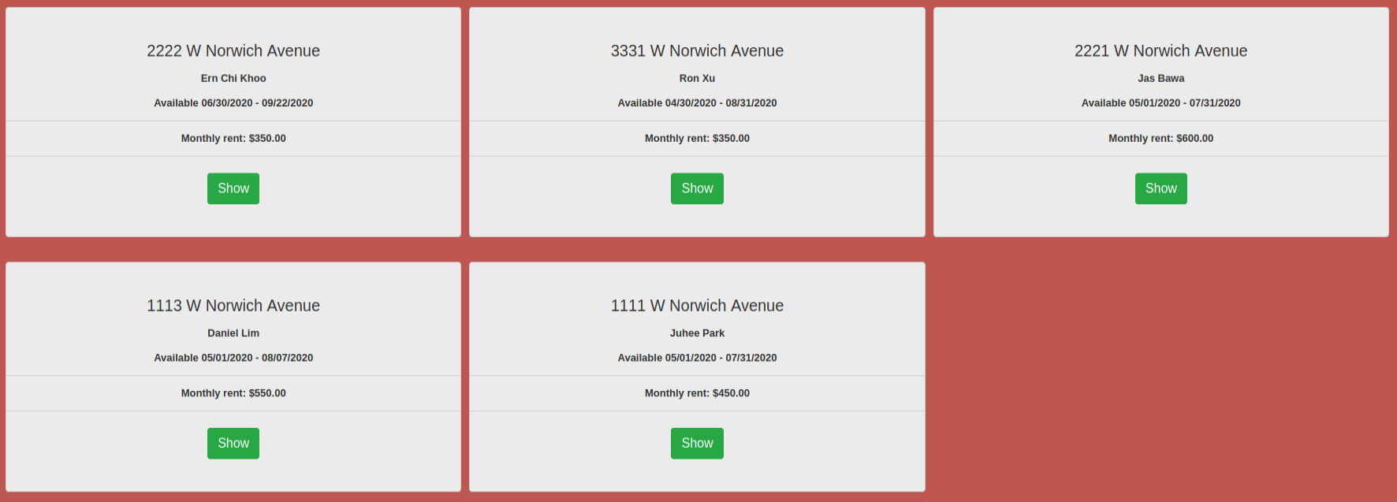
Card Design
A material design layout to keep individual sections organized
Card design was created using Bootstrap classes

Slide 34
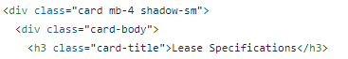
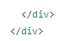
Bootstrap for Cards
Used card class for easy creation of a simple card
card-body and card-title classes to maintain a consistent style
.
. Content
.

Slide 35
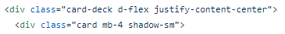
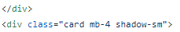
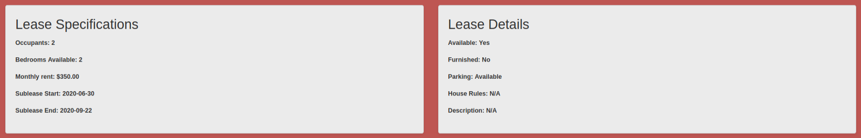
Bootstrap for Cards
card-deck class for row grouping with similar style
.
. Content
.
.
. Content
.

Slide 36
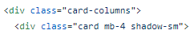
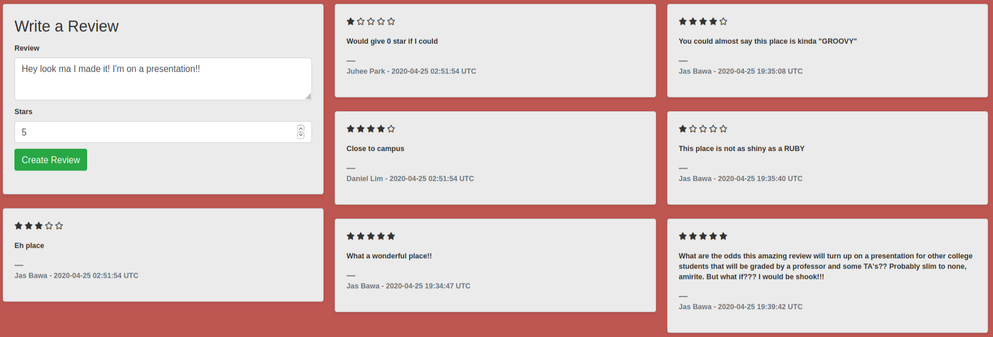
Bootstrap for Cards
.
. Content
.
card-columns class for creating a collage of similar cards but varying sizes
.
. Content
.
.
. More cards
.

Slide 37
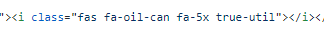
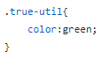

Font Awesome Icons
A free icon library
Icons act as inline elements, inheriting CSS rules for color and size

Slide 38
Static Site Generation Using Middleman

Slide 39
Uses of Middleman
Using application layout file for all pages
Single point of control for scripts and navigation bar
Partials to place information from multiple models on one page
Ruby Code to generate HTML in erb files

Slide 40
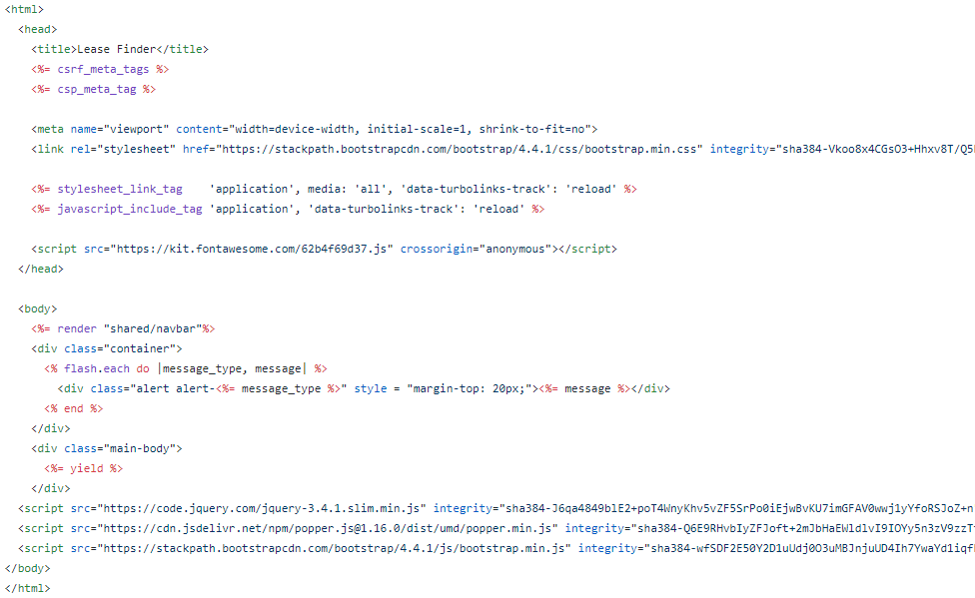
Middleman Layout File
Allowed to render a single navigation bar
Add Bootstrap and Font Awesome libraries to every page
Keep a container ready for messages resulting from any action

Slide 41
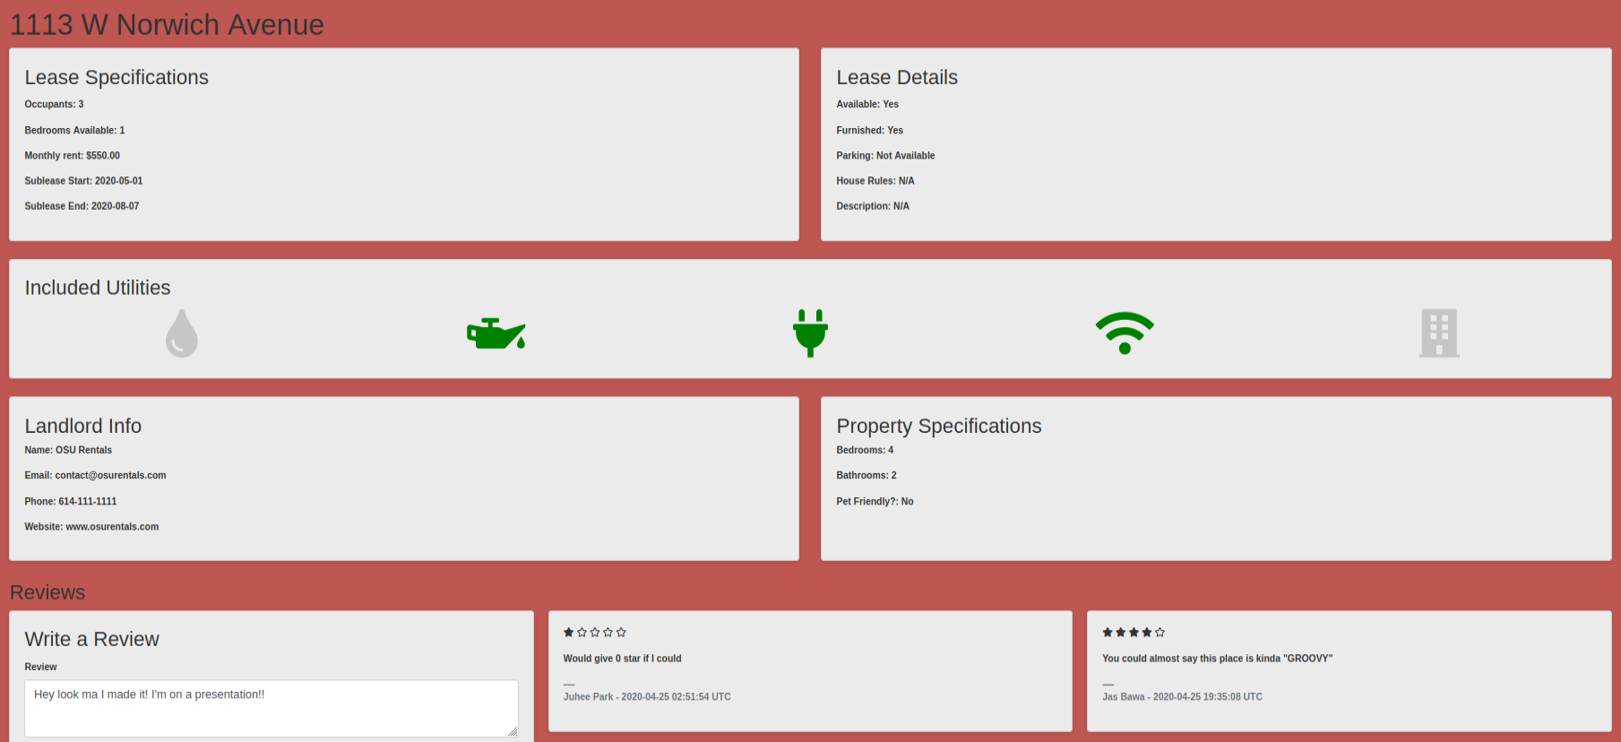
Middleman Partials

Slide 42
Middleman Partials
In sublet_post/show.html.erb
.
. Sublet Post Content
.
Sublet post page uses two partials
Property partial
New review partial
Partials were brought together using render

Slide 43
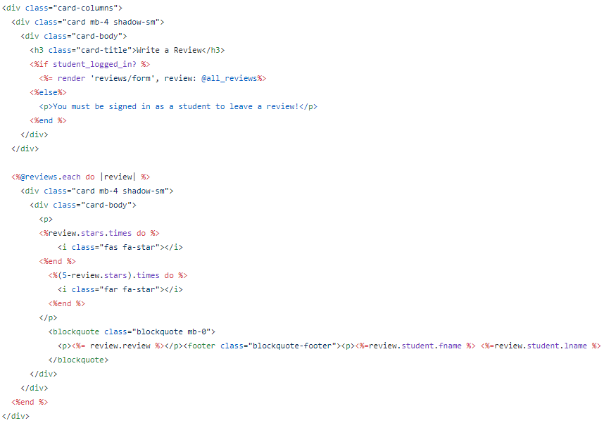
Middleman Ruby + HTML
Combined Ruby and HTML to display all reviews

Slide 44
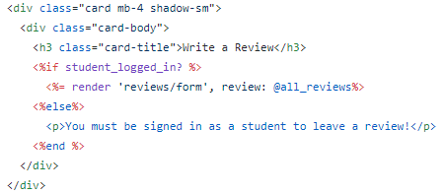
Middleman Ruby + HTML
Boolean return from function allows for user to write review

Slide 45
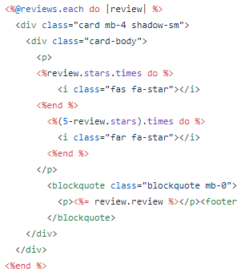
Middleman Ruby + HTML
Loop through all reviews for a property and displays them on individual cards

Slide 46
Thank you

